Slide 1


Slide 2
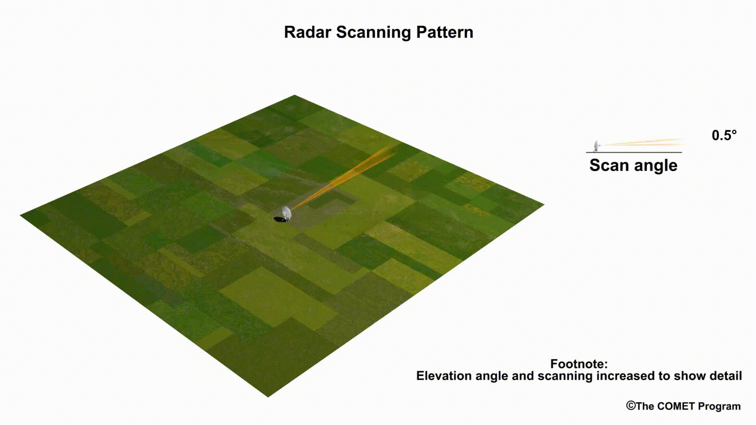
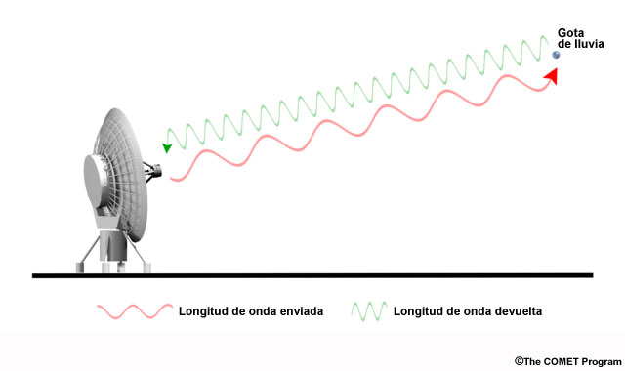
Radares

Slide 3
Datos
V =
azimut =
4327
azimut
rango
rango =
480
480 x 4327
elevación =
4327
matriz de 480 x 4327 elementos

Slide 4
dataframe
vol =
V =
azimut
Rango V azimut elevacion
1
2
vol <- melt(V, value.name = "V")
1
1
rango
1
1
vol$elevacion <- rep(elevacion,
each = length(rango))
1
1
2
1
1
1
1
2
2
2
2
2
1
2
2
elevación
2
2
2
…
Total = 2.076.960 observaciones

Slide 5
Gráficos

Slide 6
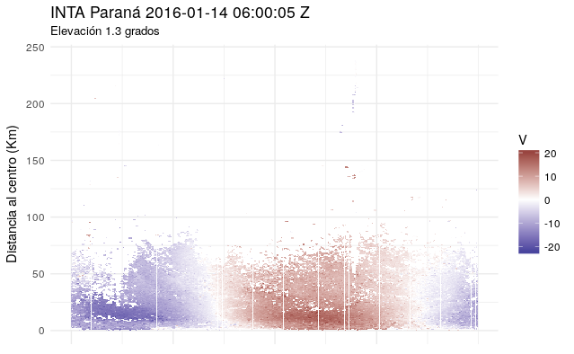
ggplot(subset(vol, elevacion == elev[3] & !is.na(V)), aes(azimut, rango/1000)) +
geom_tile(aes(fill = V)) +
scale_fill_gradient2(low = muted("blue"), high = muted("red")) +
scale_x_continuous(name = NULL, labels = NULL, breaks = seq(0, 359, 90)) +
ylab("Distancia al centro (Km)") +
labs(title = "INTA Paraná 2016-01-14 06:00:05 Z", subtitle = "Elevación 1.3 grados") +
#coord_polar() +
theme_minimal()

Slide 7
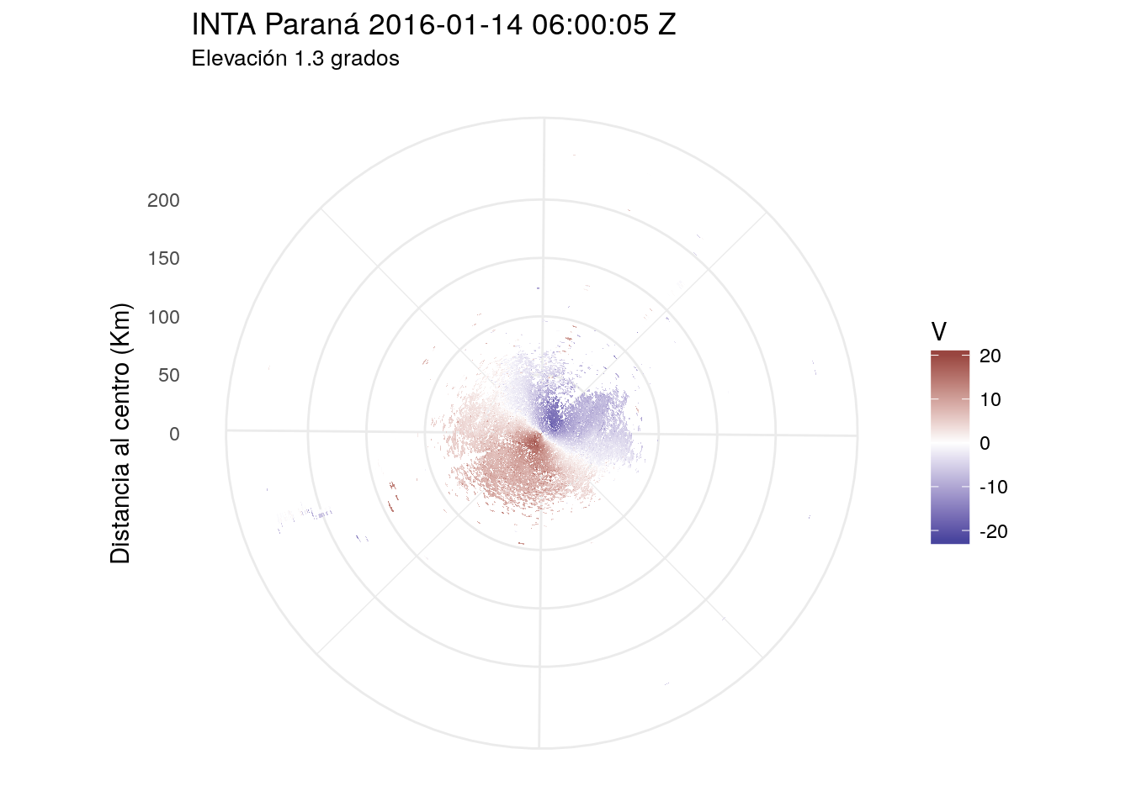
ggplot(subset(vol, elevacion == elev[3] & !is.na(V)), aes(azimut, rango/1000)) +
geom_tile(aes(fill = V)) +
scale_fill_gradient2(low = muted("blue"), high = muted("red")) +
scale_x_continuous(name = NULL, labels = NULL, breaks = seq(0, 359, 90)) +
ylab("Distancia al centro (Km)") +
labs(title = "INTA Paraná 2016-01-14 06:00:05 Z", subtitle = "Elevación 1.3 grados") +
coord_polar() +
theme_minimal()

Slide 8

ggplot(subset(vol, elevacion == elev[3] & !is.na(V)), aes(azimut, rango/1000)) +
geom_point(aes(color = V, size = rango)) +
scale_color_gradient2(low = muted("blue"), high = muted("red")) +
scale_size_area(max_size = 0.1) +
scale_x_continuous(name = NULL, labels = NULL, breaks = seq(0, 359, 90)) +
guides(size = "none") +
ylab("Distancia al centro (Km)") +
labs(title = "INTA Paraná 2016-01-14 06:00:05 Z", subtitle = "Elevación 1.3 grados") +
coord_polar() +
theme_minimal()

Slide 9
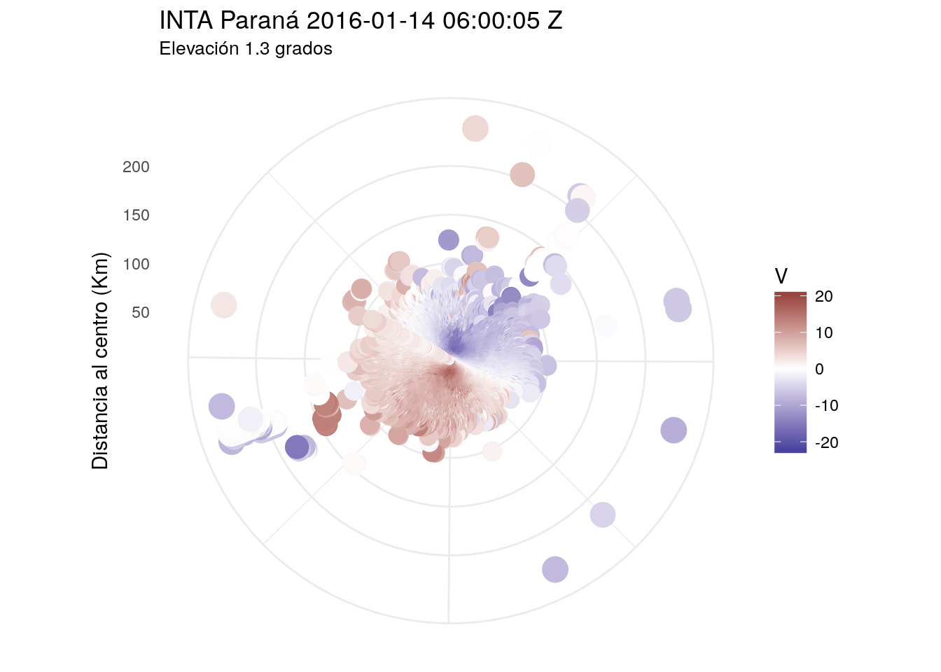
ggplot(subset(vol, elevacion == elev[3] & !is.na(V)), aes(azimut, rango/1000)) +
geom_point(aes(color = V, size = rango)) +
scale_color_gradient2(low = muted("blue"), high = muted("red")) +
#scale_size_area(max_size = 0.1) +
scale_x_continuous(name = NULL, labels = NULL, breaks = seq(0, 359, 90)) +
guides(size = "none") +
ylab("Distancia al centro (Km)") +
labs(title = "INTA Paraná 2016-01-14 06:00:05 Z", subtitle = "Elevación 1.3 grados") +
coord_polar() +
theme_minimal()

Slide 10
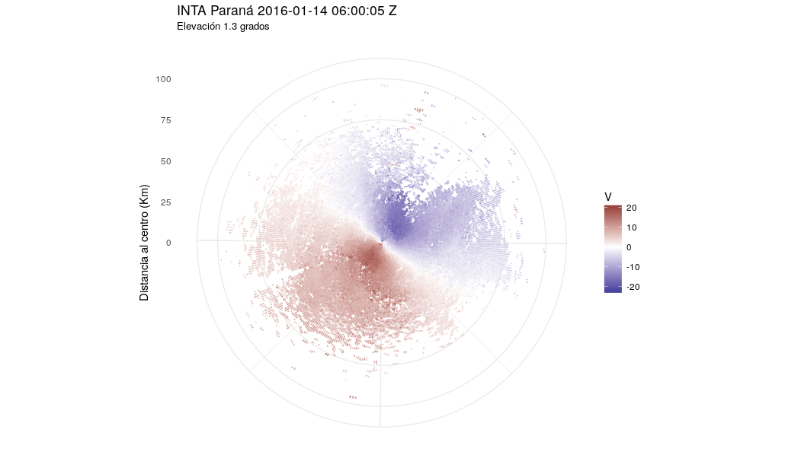
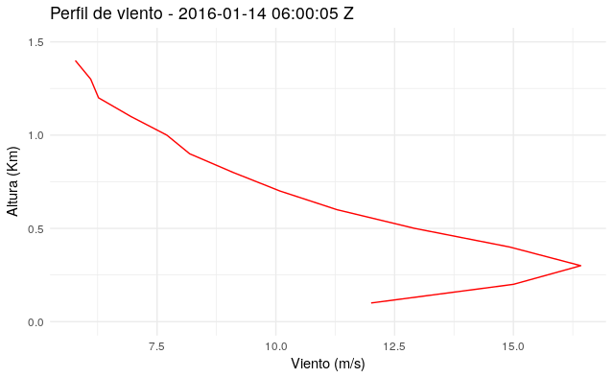
Algunos resultados
Viento radial → Viento horizontal
Viento del sur oeste
Máximo cerca de superficie

Slide 11
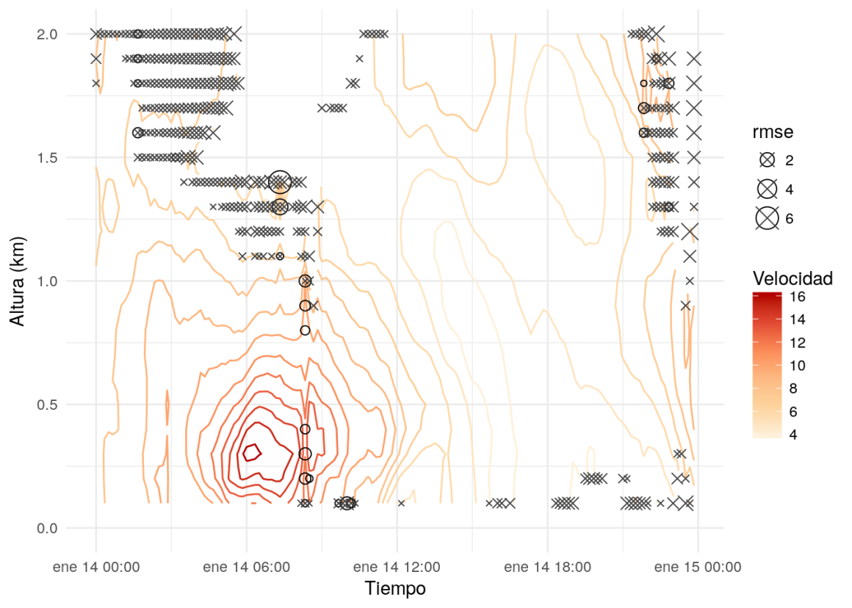
Magnitud del viento
ggplot(vad_14_240, aes(date_time, ht)) +
geom_contour(aes(z = spd, color = ..level..), binwidth = 1) +
scale_color_distiller(name = "Velocidad", type = "seq", palette = 8, direction = 1) +
geom_point(data = subset(vad_14_240, rmse > 0.5), aes(size = rmse), shape = 1, color = "black") +
geom_point(data = subset(vad_14_240, rmse2 > 0.5), aes(size = rmse2), shape = 4, color = "grey25") +
ylim(c(0,2)) +
xlab("Tiempo") +
ylab("Altura (km)") +
theme_minimal()

Slide 12
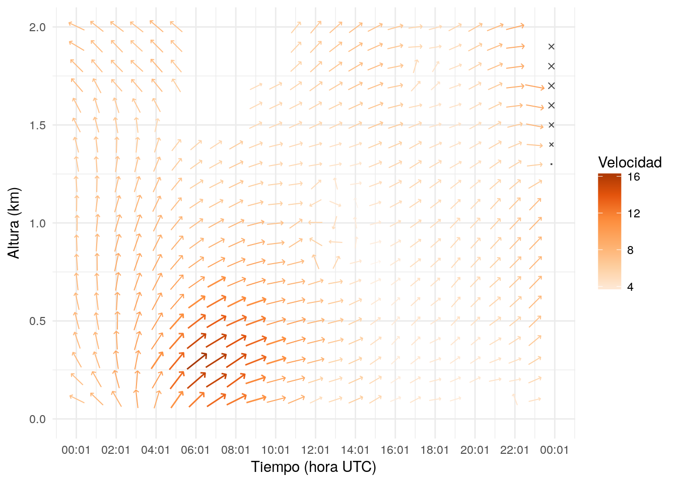
Dirección del viento
ggplot(subset(vad_14_240, minute(date_time) == 0), aes(date_time, ht)) +
geom_arrow(aes(mag = spd, angle = di, color = spd)) +
geom_point(data = subset(temp, rmse > 0.5), aes(size = rmse), shape = 1, color = "black") +
geom_point(data = subset(temp, rmse2 > 0.5), aes(size = rmse2), shape = 4, color = "grey25") +
scale_size_continuous(range = c(0, 5), guide = "none") +
scale_color_distiller(palette = "Oranges", name="Velocidad", direction = 1) +
xlab("Tiempo (hora UTC)") + ylab("Altura (km)") +
scale_x_datetime(date_breaks = "2 hour", date_labels = "%H z") +
ylim(c(0,2)) +
theme_minimal()

Slide 13



¡Gracias!
paobcorrales@gmail.com
github.com/paocorrales/Charla_R-Ladies
@paobcorrales

